Slide 1
Singapore Travel Guide Project Milestone #3 Code Monkey Team

Slide 2
Outline
Overview
UI Design Diagram
Image Processing
Car Detection
SQL
Cloud Architecture
Web Server On Cloud
Image Processing On Cloud
Elasticity & Scalability
Implementation Plan
14 Jul

Slide 3
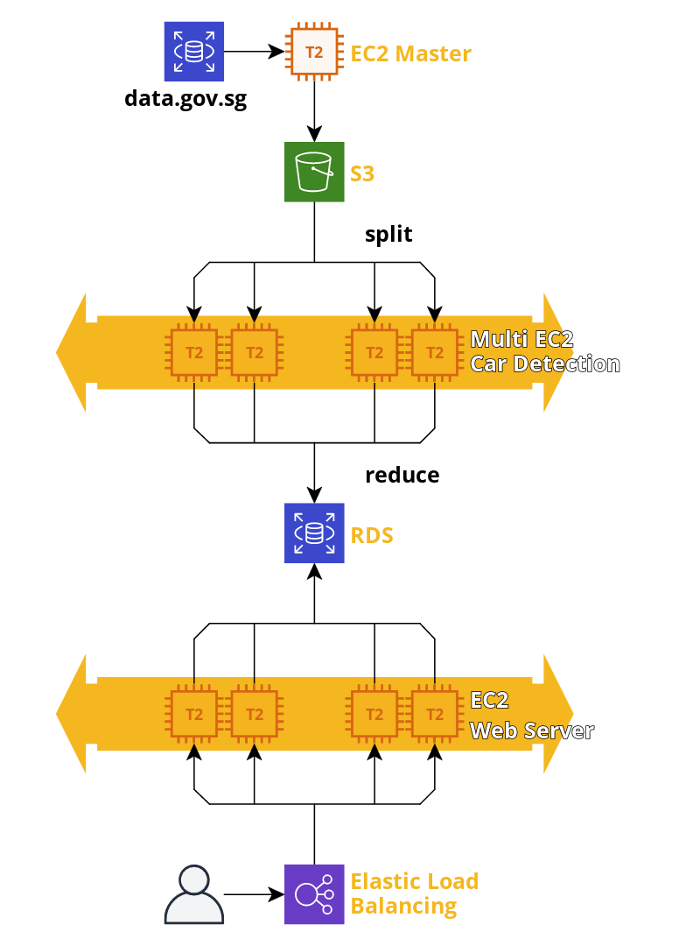



Overview
14 Jul

Slide 4
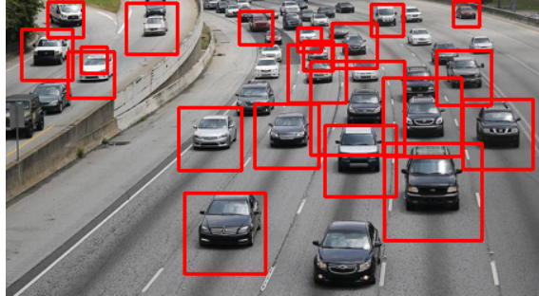
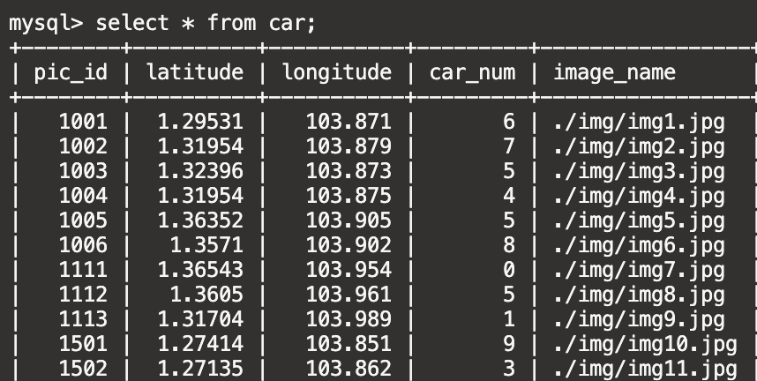
Back-End with Spark
Car Detection and Storage
Use anchor boxes to mark cars and count the num of anchor boxes
Runs every 5 minutes to fetch the data from data.gov.sg and process it in AWS EC2
Use AWS RDS to store the result.
The front-end will get the information from SQL and print it in the map
14 Jul

Slide 5

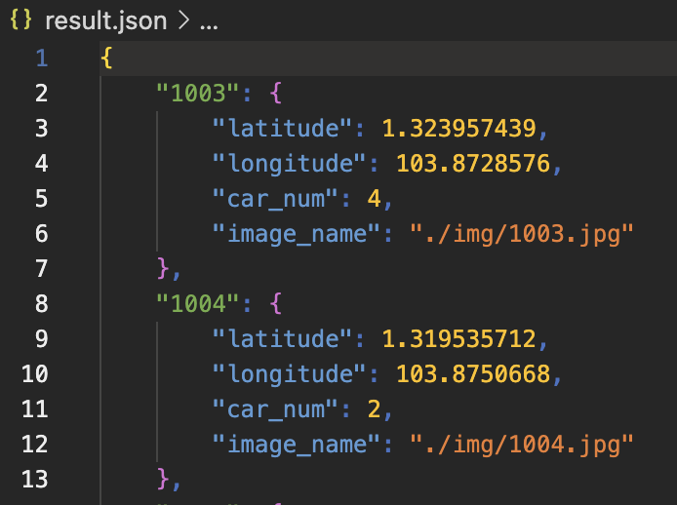
What is new
Spark framework
Run in AWS EMR
Map the dataset to each node and collect results from them
Solve the incompatibility problem between opencv and pyspark by using subprocessor
Solve the memory overflow by map paths instead of image itself
14 Jul

Slide 6
Implementation Plan
Yao Chenxun | Car-Detection, EMR with Spark, RDB storage
Tang Tang | Cloud Architecture, front end
Zhu Yundian | Vue framework, RDB storage, web page
Liu chenghang | Web page
14 Jul

